Slide 1

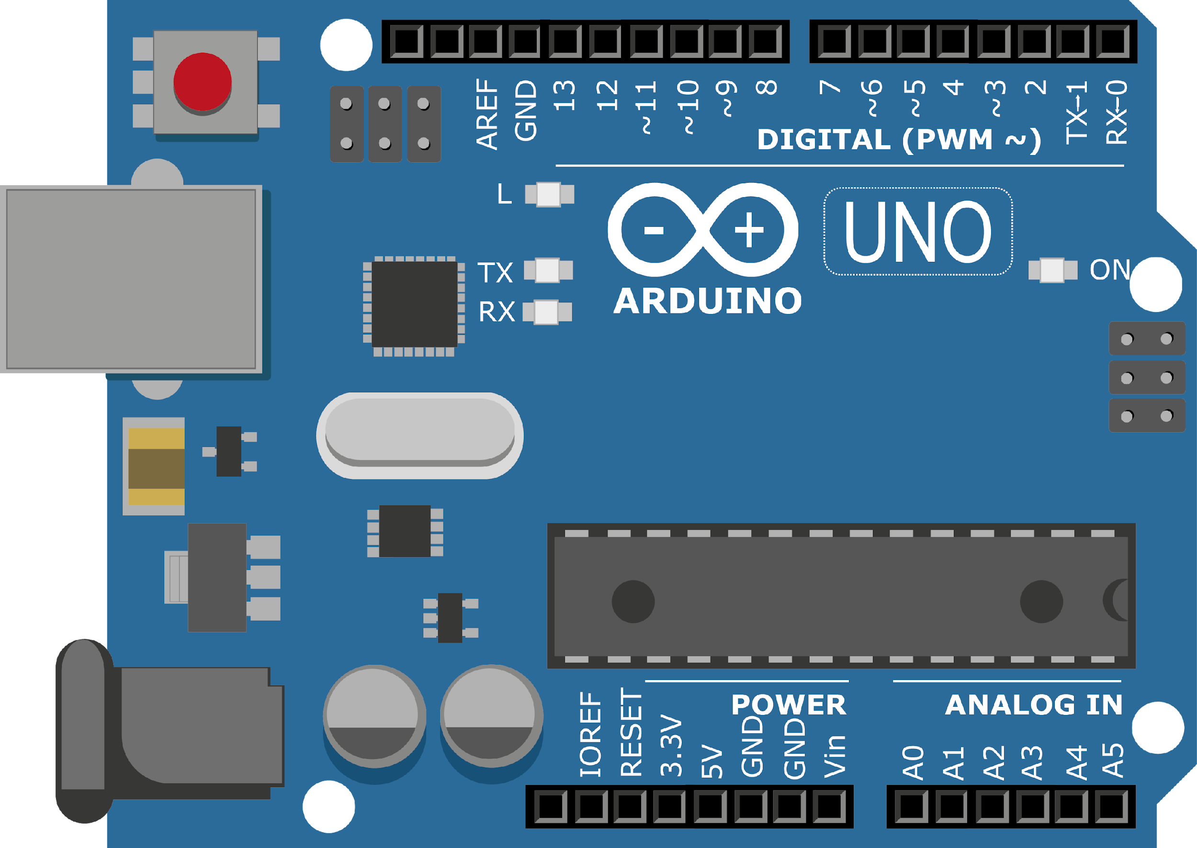
ARDUINO MASTER CLASS
06
LCD Interface | I2C

Slide 2
6 AGENDA
02
03
01
I2C
Protocol
Q & A
LCD Interface with Arduino with & without I2C

Slide 3
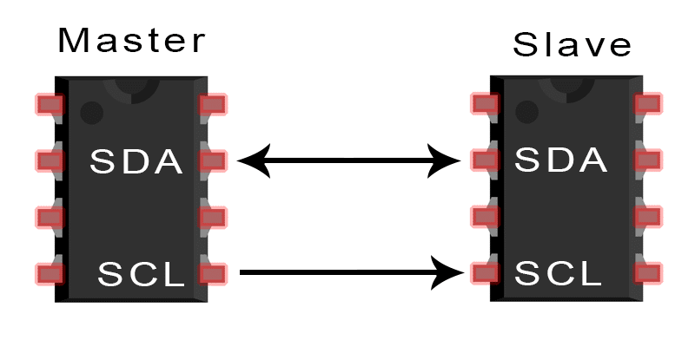
I2C – Inter Integrated Circuit
you can connect multiple slaves to a single master (like SPI) and you can have multiple masters controlling single, or multiple slaves.
Like UART communication, I2C only uses two wires to transmit data between devices:
SDA (Serial Data) – The line for the master and slave to send and receive data.
SCL (Serial Clock) – The line that carries the clock signal.

Slide 4
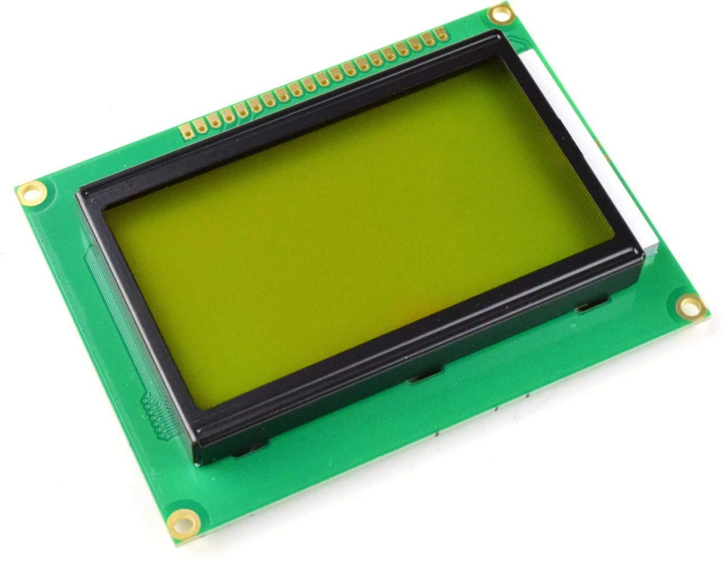
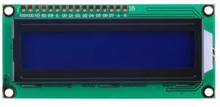
LCD - Liquid Crystal Display
It is a type of flat panel display which uses liquid crystals in its primary form of operation.
16×2 character LCD
GLCD

Slide 5
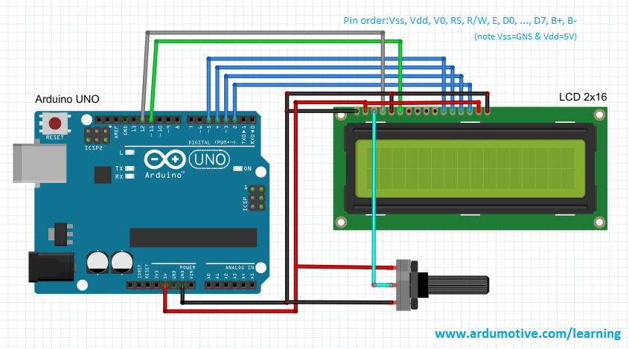
16x2 LCD with Arduino

Slide 6
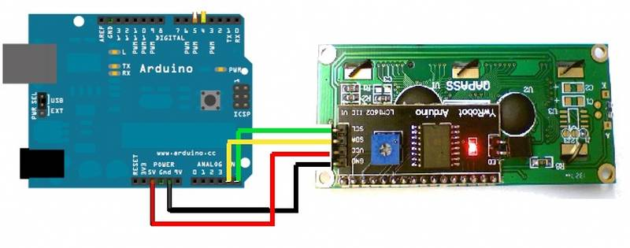
16x2 LCD with Arduino using I2C

Slide 7

INTERVIEW QUESTIONS
I2C is half-duplex or full-duplex?
Commands of LCD
What is I2C communication
Half-duplex devices can only transmit in one direction at one time. With half-duplex mode, data can move in two directions, but not at the same time.
I2C is a serial communication protocol.I2C is basically a two-wire communication protocol. It uses only two wire for communication. In which one wire is used for the data (SDA) and other wire is used for the clock (SCL).

Slide 8
For Hex Code-01, the LCD command will be the clear LCD screen
For Hex Code-02, the LCD command will be returning home
For Hex Code-04, the LCD command will be decrement cursor
For Hex Code-06, the LCD command will be Increment cursor
For Hex Code-05, the LCD command will be Shift display right
For Hex Code-07, the LCD command will be Shift display left
For Hex Code-08, the LCD command will be Display off, cursor off
For Hex Code-0A, the LCD command will be cursor on and display off
For Hex Code-0C, the LCD command will be cursor off, display on
For Hex Code-0E, the LCD command will be cursor blinking, Display on
For Hex Code-0F, the LCD command will be cursor blinking, Display on
For Hex Code-10, the LCD command will be Shift cursor position to left
For Hex Code-14, the LCD command will be Shift cursor position to the right
For Hex Code-18, the LCD command will be Shift the entire display to the left
For Hex Code-1C, the LCD command will be Shift the entire display to the right
For Hex Code-80, the LCD command will be Force cursor to the beginning ( 1st line)
For Hex Code-C0, the LCD command will be Force cursor to the beginning ( 2nd line)
For Hex Code-38, the LCD command will be 2 lines and 5×7 matrix
LCD 16×2 Arduino

Slide 9

THANKS!

